Slide 1
Comparison of Reinforcement Learning and Backpropagation on Controlling a Simulated Car
Cliona Hayden
BSc(Hons) Computer Games Development
C00225401
Supervisor: Dr Oisin Cawley

Slide 2
Introduction
AI and machine learning is now a large part of our everyday lives
Marketing, Banking, Speech recognition, medical diagnosis, Online Advertising etc.

Slide 3
My Aim
Compare Backpropagation and Reinforcement learning under certain headings
Ease of Implementation
Learning Speed
Accuracy

Slide 4
Technologies Used
C++
Used for the main program and the reinforcement learning algorithm
SFML
Used to display any visuals in the program
Python
Used to run the backpropagation algorithm
TensorFlow
Used for writing the backpropagation algorithm in Python

Slide 5
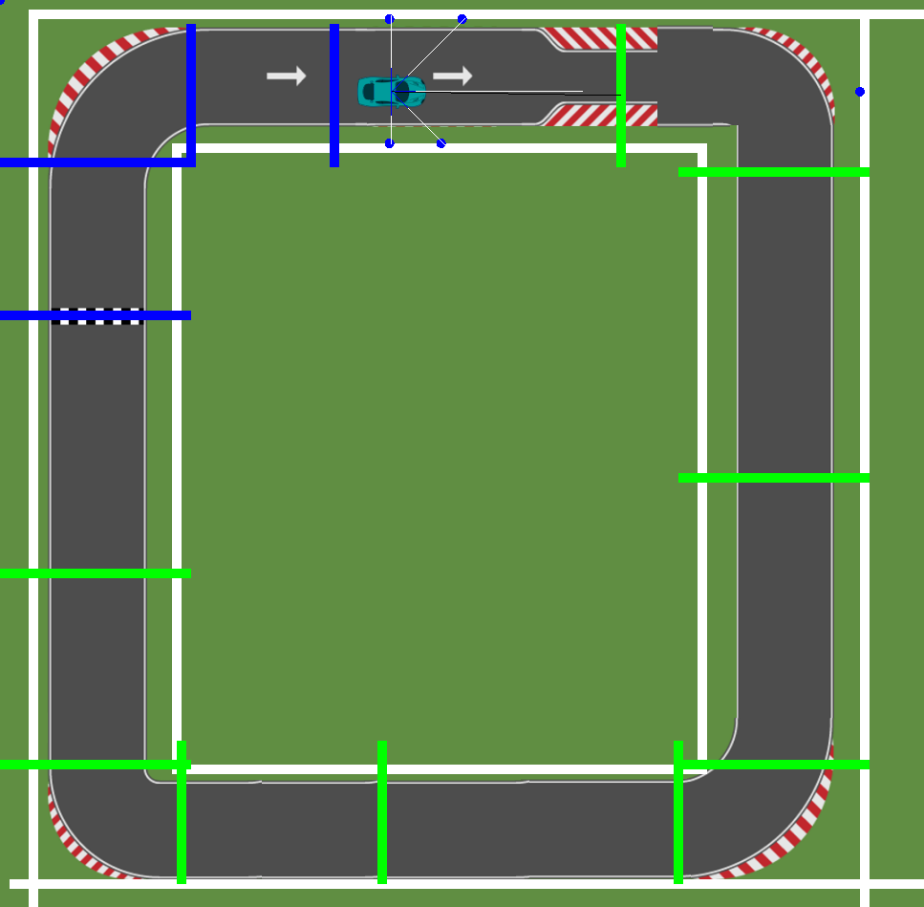
Methods
Main Demo
The main demo is programmed in C++ using the SFML library for any visuals.
All neural networks are run in the C++ program

Slide 6
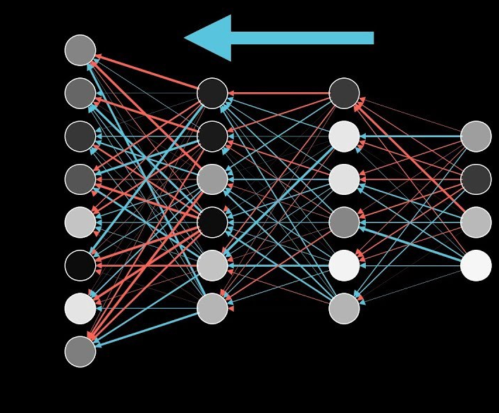
Methods
Backpropagation
Training data is collected in the C++ application and saved to an external file
Training data loaded into python script and backpropagation is run using the functions from the TensorFlow library
Calculated weights saved to an external file
Weights loaded into C++ program and used to evaluate neural network

Slide 7
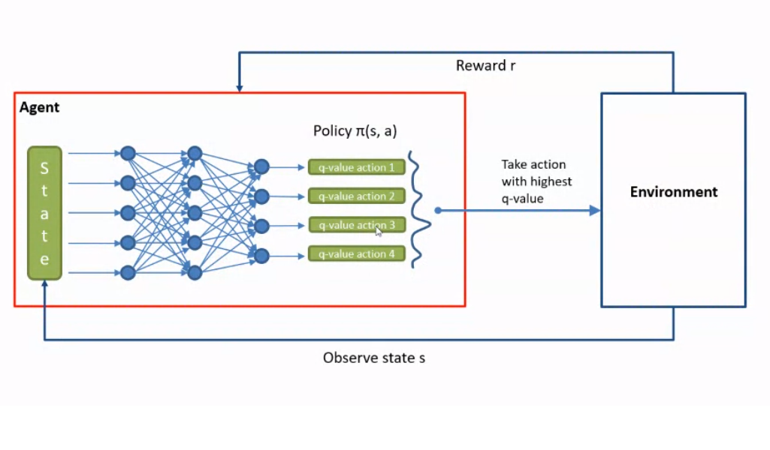
Methods
Reinforcement Learning
All reinforcement learning is programmed in the same C++ project from scratch using no external libraries.
Calculated weights are stored to an external file
Uses deep Q-learning as the learning method

Slide 8
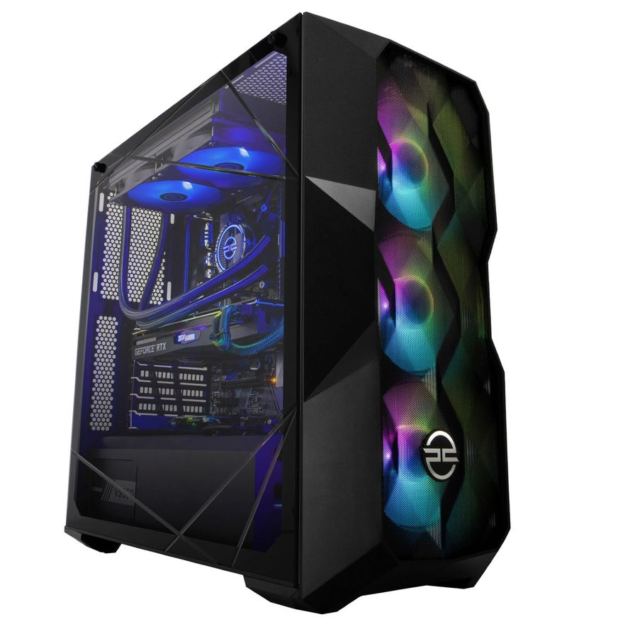
Computer Specs
Both algorithms were trained on the same machine
AMD Ryzen 7 5800X Processor
RAM: 16 GB

Slide 9
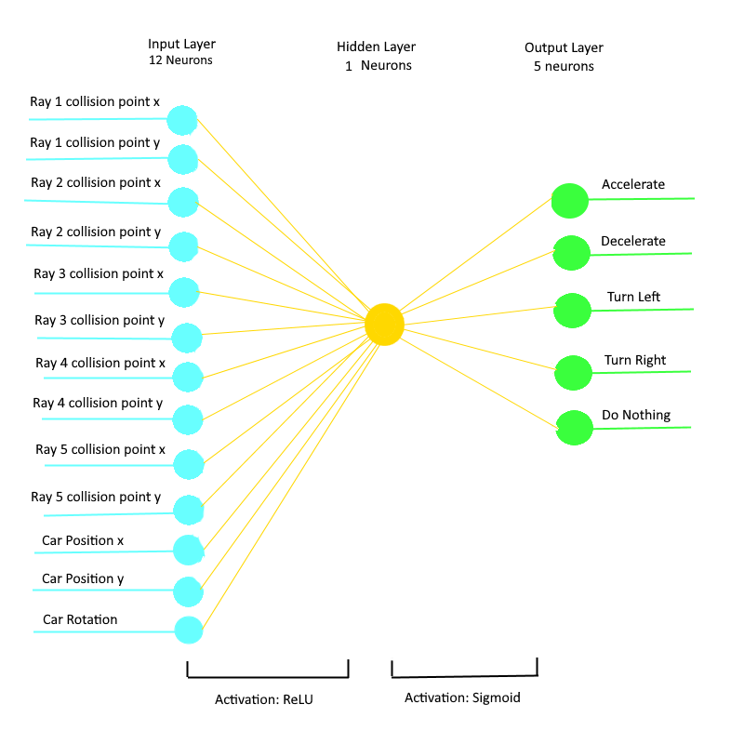
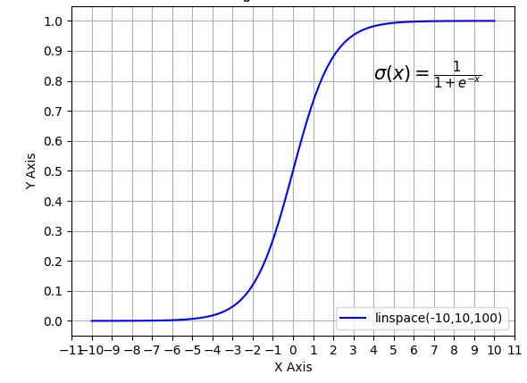
Neural Network
Takes a lot of trial and error to implement successfully
After a lot of testing, I settled with a neural network of 13 inputs, 1 hidden layer consisting of 1 node, and 5 outputs
ReLU activation function: if value is less than 0, return o. Otherwise return the value
Sigmoid activation function: makes the outputs less linear by applying them to the Sigmoid curve

Slide 10
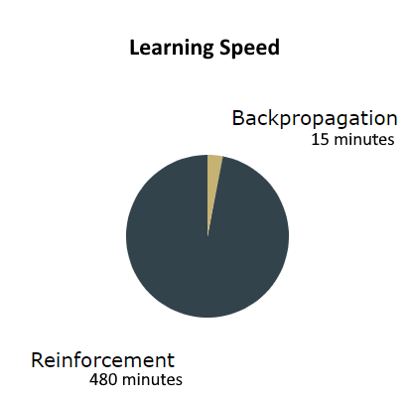
Results
Learning Speed
Backpropagation
Was significantly faster than Reinforcement
Collecting training data took the most time
Running algorithms took a few minutes
Reinforcement
Took several hours to train
Needed little to no human input

Slide 11
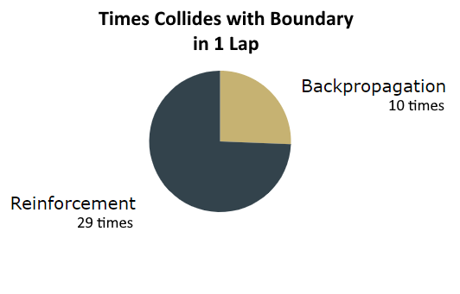
Results
Accuracy
Backpropagation
Algorithm accuracy ~90%
Car can get caught on corners
Reinforcement
Can also get stuck on corners, not as often
More training time results in more accurate model

Slide 12
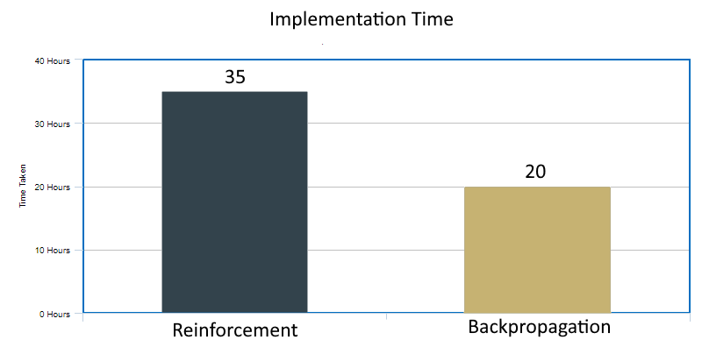
Results
Ease of Implementation
Backpropagation
Easier and quicker to implement
Without using TensorFlow may take significantly longer
Reinforcement
Took a lot longer as I wrote the algorithm from scratch
Took a lot of research and debugging to implement successfully

Slide 13
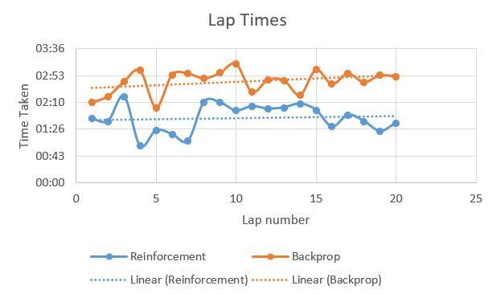
Results
Lap Times
Backpropagation
Slower overall
Reinforcement
Faster
Could get stuck, resulting in invalid data

Slide 14
Review
Took a lot of time to learn about neural networks and the learning methods
Constantly changed network architecture
I am happy with the technologies chosen
Reinforcement learning’s weights adjustment slightly inaccurate

Slide 15
What I Would do Differently
Program the entire project in Python
Research into different machine learning libraries
Start working on reinforcement learning earlier
Take more time on reinforcement learning than backpropagation

Slide 16
Future Work
This project can be expanded on by:
Observing this neural network on a different track
Further experimentation with Q-learning weight adjustment so it continues to learn
Training the network with other algorithms e.g. Genetic Algorithms
Comparing the trained network to a human player

